Slide 1
Spring Boot Introduction
Rongas Alexandros
2019

Slide 2
Agenda
Why Spring boot
Spring projects and fist introduction to Spring-io web site
Spring initilzr
Spring Boot starters-versioning
Spring Boot Auto Configuration
Spring Boot Embedded Servers
Spring Boot Application Example
Simple web application creation with spring boot
Connection with elasticsearch as a data source and expose entities via rest

Slide 3
Why Spring Boot
Convention over configuration
Sensible defaults
Auto configuration
Starter POMS
Easy handling of dependencies
Autonomous
Features set
Easy integration

Slide 4
Spring projects
Project | Description
Spring Framework | Core support for dependency injection, transaction management, web application development, data access, messaging, etc
Spring Boot | Spring Boot makes it easy to create stand-alone, production-grade Spring based Applications that you can "just run". It is build on top of Spring framework
Spring Data | Provides a consistent approach to database access
Spring Integration | Extends the Spring programming model to support the well-known Enterprise Integration Patterns
Spring Cloud | Spring Cloud provides tools to quickly build some of the common patterns in distributed systems (e.g. configuration management, service discovery, circuit breakers, intelligent routing, micro-proxy, control bus,).

Slide 5
Spring projects
Project | Description
Spring Cloud Data Flow | Spring Cloud Data Flow is a toolkit for building data integration and real-time data processing pipelines.
Spring Batch | Simplifies and optimizes the work of accessing, processing and exporting high volume batch data
Spring Security | Provides the means of application authentication and authorization.
Spring HATEOAS | Provides the support of creating rest interface that follows the HATEOAS principle
Spring Rest Docs | It combines hand-written documentation written with Asciidoctor and auto-generated snippets produced with Spring MVC Test. It helps you to produce documentation that is accurate, concise, and well-structured.

Slide 6
Spring projects
Project | Description
Spring AMQP | The Spring AMQP project applies core Spring concepts to the development of AMQP-based messaging solutions. It provides a "template" as a high-level abstraction for sending and receiving messages.
Spring Mobile | Spring Mobile is a framework that provides capabilities to detect the type of device making a request to your Spring web site and serve alternative views based on that device.
Spring For Android | Spring for Android is a framework that is designed to provide components of the Spring family of projects for use in Android apps.

Slide 7
Spring projects
Project | Description
Spring Web Services | Spring Web Services (Spring-WS) is a product of the Spring community focused on creating document-driven Web services. Spring Web Services aims to facilitate contract-first SOAP service development.
Spring LDAP | Spring integration with LDAP
Spring Session | Spring session provides a framework for managing user’s session information
Spring Shell | Provides capabilities to build a command line application
Spring Flo | A JavaScript library that offers a basic embeddable HTML5 visual builder for pipelines and simple graphs. This library is used as the basis of the stream builder in Spring Cloud Data Flow.

Slide 8
Spring projects
Project | Description
Spring Kafka | Provides integration abstraction with Kafka (kafkaTemplate, KafkaMessageListenerContainer, KafkaListener)
Spring Statemachine | Framework support for using state machine concepts inside spring applications
Spring Web Flow | Spring Web Flow builds on Spring MVC and allows implementing the "flows" of a web application. A flow encapsulates a sequence of steps that guide a user through the execution of some business task.

Slide 9
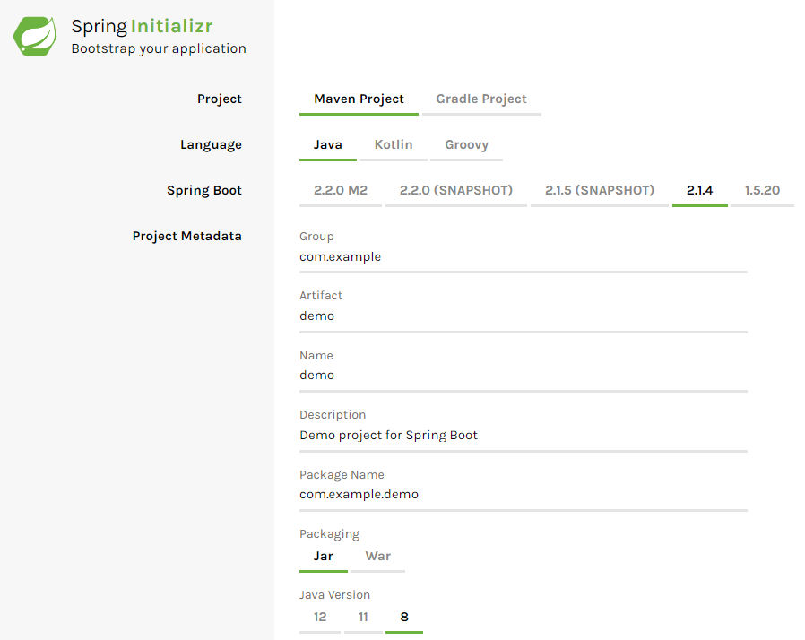
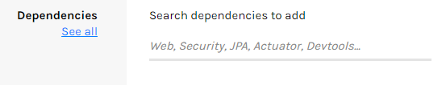
Spring initilzr
https://start.spring.io/

Slide 10
Spring Boot starters
Starters contain the dependencies needed by including all consistent, supported dependencies.
All starters follow a similar naming pattern; spring-boot-starter-*, where * is a particular type of application.
All starters start from spring-boot-starter-parent
Configuration - Java Version and Other Properties
Dependency Management - Version of dependencies
Default Plugin Configuration
spring-boot-starter-data-jpa will include all the related libraries needed for spring data and jpa

Slide 11
Spring Boot starters
Increase dependency manageability
Production-ready, tested & supported dependency configurations
Decrease the overall configuration time for the project
More easy version upgrade

Slide 12
Spring Boot Auto Configuration
Spring and Spring MVC applications have a lot of XML or Java Bean Configuration.
Spring Boot auto-configuration attempts to automatically configure your Spring application based on the jar dependencies that you have added.
Auto-configuration is non-invasive. At any point, you can start to define your own configuration to replace specific parts of the auto-configuration.

Slide 13
Spring Boot Embedded Servers
By default, spring boot creates an executable jar file using an embedded application server.
Server configuration is applicable via spring application properties

Slide 14
Spring Boot Embedded Servers
For servlet stack applications, spring-boot-starter-web includes Tomcat by default, but you can use jetty or undertow instead.
For reactive stack applications, the spring-boot-starter-webflux includes Reactor Netty by default but you can use tomcat, jetty, or undertow instead.
You can finally create a war and run a spring boot application inside another application server.

Slide 15
Review of Theory
Which are the benefits of spring
Executable jars
Convention over configuration
Starter ‘POMS’
Feature set provided from spring
Easy integration with 3rd-party services.

Slide 16
Spring Boot Application Example
Start a project with Spring initilizr (https://start.spring.io/)
Java 8,
Spring boot 2.1.x
Gradle
Dependencies: spring-boot-starter-web

Slide 17
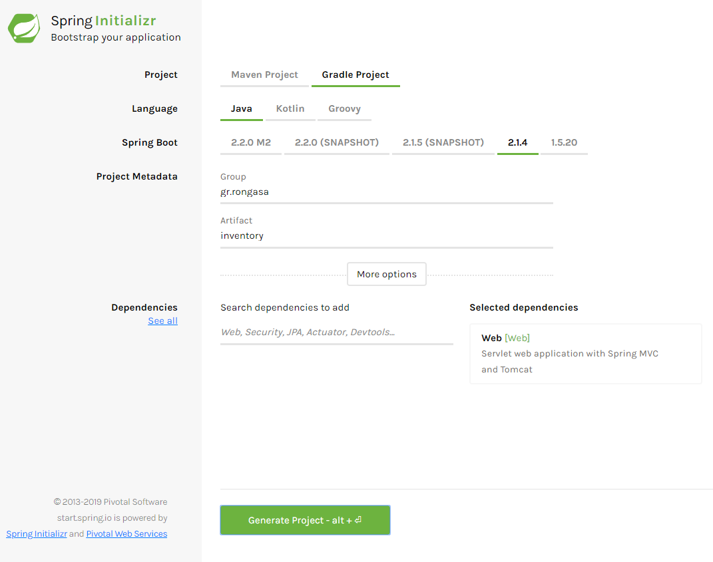
Create an empty project
Spring initializr https://start.spring.io/
Generate project
Import to Intellij or other IDE

Slide 18
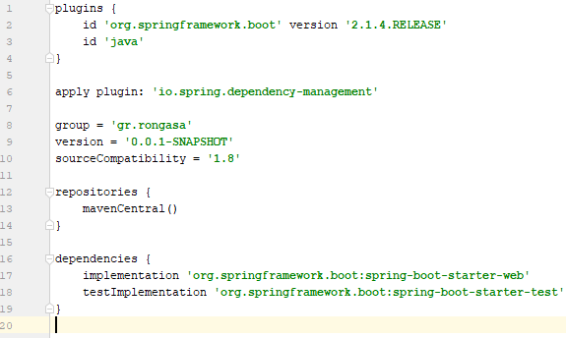
Gradle
Spring boot gradle plugin
Builds a runnable jar
Built-in dependency resolver sets the version numbers to match
Spring Boot dependencies. These can be overridden but will default to
Spring Boot’s chosen versions.
Starter dependencies – Check your project’s dependencies

Slide 19
Starting point
package gr.rongasa.inventory; import org.springframework.boot.SpringApplication; import org.springframework.boot.autoconfigure.SpringBootApplication; @SpringBootApplication public class InventoryApplication { public static void main(String[] args) { SpringApplication.run(InventoryApplication.class, args); } }
There is a main class. SpringApplication.run() is what makes all the magic.
@SpringBootApplication annotation adds the following:
@Configuration tags the class as a source of bean definitions.
@EnableAutoConfiguration tells Spring Boot to start adding beans based on
Classpath settings,
Beans, and
Various property settings.
@ComponentScan tells Spring to look for other components, configurations, etc

Slide 20
Auto configuration
Normally you would add @EnableWebMvc for a Spring MVC app create spring beans and configure mvc (servlet.xml with view resolver, web.xml, etc). @see: WebMvcAutoConfiguration
Spring Boot adds it automatically when it finds spring-webmvc on the classpath.
Flags the application as a web application
Activates key behaviours such as setting up a DispatcherServlet.

Slide 21
Rest Controller
package gr.rongasa.inventory.web.rest; import org.springframework.http.ResponseEntity; import org.springframework.web.bind.annotation.GetMapping; import org.springframework.web.bind.annotation.RestController; @RestController public class GreetingsController { @GetMapping public ResponseEntity<String> greetings(){ return ResponseEntity.ok("Hello Spring boot!"); } }
Simple rest controller annotation
Java method annotated with httm method type.
Done!
Build and run
gradlew clean build
java –jar build/libs/inventory-0.0.1-SNAPSHOT.jar

Slide 22
Connection with ElasticSearch
plugins { id 'org.springframework.boot' version '2.1.4.RELEASE' id 'java' } apply plugin: 'io.spring.dependency-management' group = 'gr.rongasa' version = '0.0.1-SNAPSHOT' sourceCompatibility = '1.8' configurations { compileOnly { extendsFrom annotationProcessor } } repositories { mavenCentral() } dependencies { implementation 'org.springframework.boot:spring-boot-starter-actuator' implementation 'org.springframework.boot:spring-boot-starter-data-elasticsearch' implementation 'org.springframework.boot:spring-boot-starter-web' compileOnly 'org.projectlombok:lombok' annotationProcessor 'org.projectlombok:lombok' testImplementation 'org.springframework.boot:spring-boot-starter-test' }

Slide 23
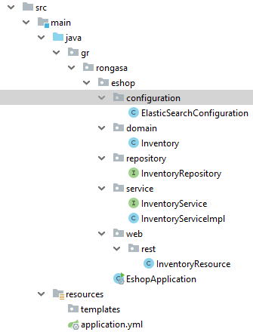
Spring boot structure
Spring boot project does not require any special
structure
That said it is important to maintain a good
structure for maintainability reasons
Configuration package keeps configuration classes
domain package keeps database domain objects
repository package keeps spring data repositories
service package keeps services
web package keeps web interface
web.rest package keeps rest interface

Slide 24
Application Properties
application.yml
application.properties
spring: application: name: e-shop data: elasticsearch: # repositories: # enabled: true cluster-nodes: localhost:9300
spring.application.name=e-shop spring.data.elasticsearch.repositories.enabled=true spring.data.elasticsearch.cluster-nodes= localhost:9300
YAML format is here to stay so lets learn using it
Less typing
YAML is more readable
YAML format can hold multiple profiles in a single file
Config Server will favor .yml over .properties (in spring cloud)

Slide 25
Domain object
package gr.rongasa.eshop.domain; import lombok.AllArgsConstructor; import lombok.Builder; import lombok.Getter; import lombok.NoArgsConstructor; import lombok.Setter; import org.springframework.data.annotation.Id; import org.springframework.data.elasticsearch.annotations.Document; import java.math.BigDecimal; @Document(indexName = "inventory") @AllArgsConstructor @NoArgsConstructor @Builder @Getter @Setter public class Inventory { @Id private String id; private String name; private Long amount; private String description; private String type; private BigDecimal cost; }
Every domain object represents
what will be written into the database
Lombok is not needed, simply
used to reduce written code
Document and id annotations make
this an elastic search database entity

Slide 26
Repository
package gr.rongasa.eshop.repository; import gr.rongasa.eshop.domain.Inventory; import org.springframework.data.domain.Page; import org.springframework.data.domain.Pageable; import org.springframework.data.elasticsearch.repository.ElasticsearchRepository; public interface InventoryRepository extends ElasticsearchRepository<Inventory,String> { Page<Inventory> findAllByType(Pageable pageable, String type); Page<Inventory> findAllByName(Pageable pageable, String type); }
Spring data repository provides seamless access to database entities.
ElasticsearchRepository comes from starter-elastic and provides CUD and pagination methods to access Inventory
One can create his own queries either by name convention or by Query annotation
On top of spring data one can find spring data rest. Will focus more in these but not just yet.

Slide 27
Service
Service uses repositories and provides/implements business logic.
This sometimes is exposed to rest via controllers while others can be scheduled jobs.
Most of the times it is a good practice that services convert the domain object to a data transfer object which is latter used in the business logic or exposed via rest or web sockets.
Consider Dozer or MapStruct for this
This practice keeps transactions with database smaller and decouple business logic from database complexity. Though there is an initial complexity of the mapping.

Slide 28
Service
@Override public Page<Inventory> findAll(Pageable pageable) { return inventoryRepository.findAll(pageable); } @Override public Page<Inventory> findAllByName(Pageable pageable, String name) { return inventoryRepository.findAllByName(pageable, name); } @Override public Page<Inventory> findAllByType(Pageable pageable, String type) { return inventoryRepository.findAllByType(pageable, type); } @Override public Inventory save(Inventory entity) { return inventoryRepository.save(entity); } @Override public Optional<Inventory> findById(String id) { return inventoryRepository.findById(id); } @Override public Optional<Inventory> deleteById(String id) { return inventoryRepository.findById(id).map(inventory -> { inventoryRepository.delete(inventory); return Optional.of(inventory); }).orElseGet(Optional::empty); }
package gr.rongasa.eshop.service; import gr.rongasa.eshop.domain.Inventory; import gr.rongasa.eshop.repository.InventoryRepository; import lombok.RequiredArgsConstructor; import org.springframework.data.domain.Page; import org.springframework.data.domain.Pageable; import org.springframework.stereotype.Service; import java.util.Optional; @RequiredArgsConstructor @Service public class InventoryServiceImpl implements InventoryService { private final InventoryRepository inventoryRepository; …. }

Slide 29
Rest Controller
@RestController @RequestMapping(value = "inventory", produces = MediaType.APPLICATION_JSON_VALUE) @RequiredArgsConstructor public class InventoryResource { private final InventoryService inventoryService; @GetMapping public Page<Inventory> findAll(Pageable pageable) { return inventoryService.findAll(pageable); } @GetMapping("type") public Page<Inventory> findAllByType(Pageable pageable, @RequestParam("type") String type) { return inventoryService.findAllByType(pageable,type); } @PostMapping public ResponseEntity<Inventory> save(@RequestBody Inventory entity) { return ResponseEntity.ok(inventoryService.save(entity)); } @PutMapping(value = "{id}") public ResponseEntity<Inventory> update(@PathVariable("id") String id, @RequestBody Inventory entity) { entity.setId(id); return ResponseEntity.ok(inventoryService.save(entity)); } @GetMapping(value = "{id}") public ResponseEntity<Inventory> findById(@PathVariable("id") String id) { return inventoryService.findById(id).map(ResponseEntity::ok).orElseGet(()->ResponseEntity.notFound().build()); } @DeleteMapping(value = "{id}") public ResponseEntity<Inventory> deleteById(@PathVariable("id") String id) { return inventoryService.deleteById(id).map(ResponseEntity::ok).orElseGet(()->ResponseEntity.notFound().build()); } }

Slide 30
Rest Controller
There will be a different session for proper rest interface
Currently lets focus on:
@RestController
@RequestMapping
@GetMapping, @PostMapping, @PutMapping, @DeleteMapping,
@PathVariable, @RequestBody , @RequestParam

Slide 31
Configuration
Configuration can be either in properties file or in java classes. Depends on the scenario and what each developer is used with.
package gr.rongasa.eshop.configuration; import lombok.extern.slf4j.Slf4j; import org.springframework.boot.CommandLineRunner; import org.springframework.context.annotation.Bean; import org.springframework.context.annotation.Configuration; import org.springframework.data.elasticsearch.repository.config.EnableElasticsearchRepositories; @Configuration @EnableElasticsearchRepositories(basePackages = {"gr.rongasa.eshop.repository"}) @Slf4j public class ElasticSearchConfiguration { @Bean public CommandLineRunner stupidBean(){ return new CommandLineRunner() { @Override public void run(String... args) throws Exception { log.info("Elastic search Configuration java code started"); } }; } }

Slide 32
Code
Git: https://github.com/arongas/eshop.git
branch: elasticSearch
git clone https://github.com/arongas/eshop.git
git fetch
git checkout test

